Slide 1

Green Pace
Security Policy Presentation
Developer: Walter Augustine

Slide 2

OVERVIEW: DEFENSE IN DEPTH
The security policy was created to provide a consistent implementation standard of security principles that will be applied to all developed applications. The policy is comprehensive and covers every layer of the organization from top to bottom.

Slide 3
THREATS MATRIX
Likely STD-002-CPP STD-003-CPP STD-004-CPP STD-005-CPP STD-006-CPP STD-007-CPP STD-008-CPP STD-010-CPP | High Priority STD-002-CPP STD-003-CPP STD-004-CPP STD-005-CPP STD-008-CPP
Low priority STD-001-CPP STD-006-CPP STD-007-CPP | Unlikely STD-001-CPP STD-009-CPP

Slide 4
10 PRINCIPLES
Validate Input Data
STD-003-CPP Guarantee that storage for strings has sufficient space for character data and the null terminator.
Heed Compiler Warnings
STD-001-CPP Never qualify a reference type with const or volatile.
STD-002-CPP Copy operations must not mutate the source object.
STD-008-CPP Do not read uninitialized memory.
Architect and Design for Security Policies
Keep It Simple
STD-005-CPP Do not access freed memory.
STD-009-CPP Do not Modify the standard namespaces.
STD-010-CPP Prefer special member functions and overloaded operators to C Standard Library functions.
Default Deny
Adhere to the Principle of Least Privilege
Sanitize Data Sent to Other Systems
STD-004-CPP Sanitize data passed to complex subsystems.
Practice Defense in Depth
Use Effective Quality Assurance Techniques
STD-006-CPP Assert liberally.
STD-006-CPP Handle all exceptions.
Adopt a Secure Coding Standard

Slide 5
CODING STANDARDS
STD-001-CPP: Never qualify a reference type with const or volatile.
STD-002-CPP: Copy operations must not mutate the source object.
STD-003-CPP: Guarantee that storage for strings has sufficient space for character data and the null terminator.
STD-004-CPP: Sanitize data passed to complex subsystems.
STD-005-CPP: Do not access freed memory.
STD-006-CPP: Assert liberally.
STD-007-CPP: Handle all exceptions.
STD-008-CPP: Do not read uninitialized memory.
STD-009-CPP: Do not modify the standard namespaces.
STD-010-CPP: Prefer special member functions and overloaded operators to C Standard Library functions.

Slide 6
ENCRYPTION POLICIES
In Flight
Data should always be transmitted over a secure connection. Insecure connections should be limited to non-sensitive data only if a secure connection is not possible.
Examples: HTTPS, SSL, FTPS
At Rest
Hard disks, databases and other forms of data storage should all use encryption.
In Use
There are few use cases for encryption in-use, but if a trusted execution environment needs to provide encryption of data in memory, then specialized hardware solutions from Intel (SGX) and ARM (TrustZone) can be investigated for their specific use.

Slide 7
TRIPLE-A POLICIES
Authentication
Username and strong password
Passwords will expire every 60 days and cannot be reused.
Authorization
Default deny: users must be granted permissions explicitly
Accounting
System will maintain a log of all user actions
Log entries will be automatically deleted after 30 days

Slide 8
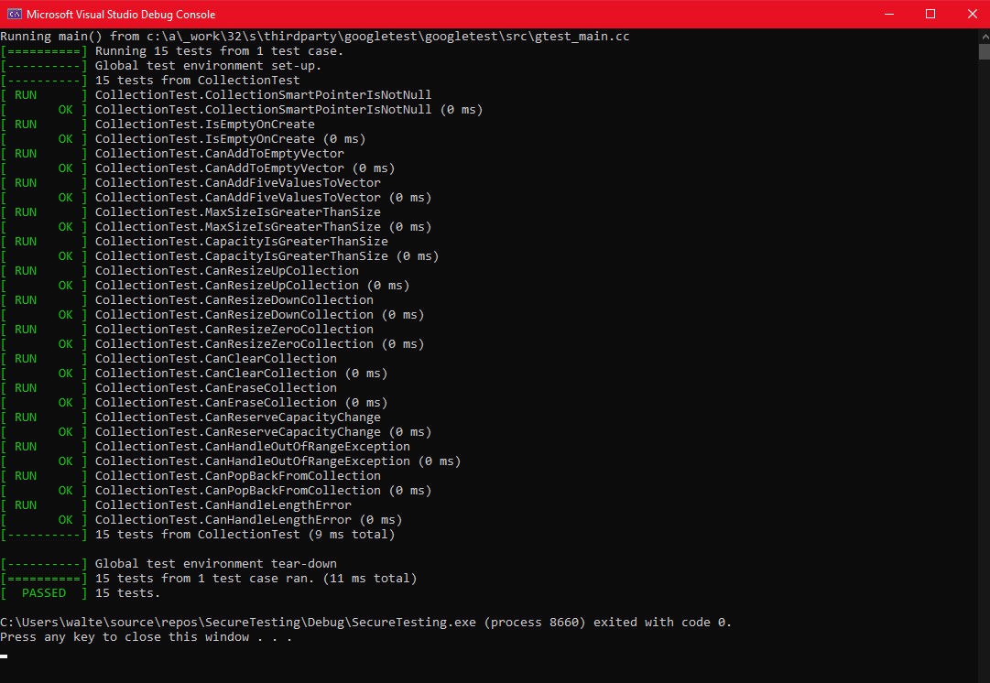
Unit Testing
Use a combination of unit tests, as shown on the right with the Google Test framework, and static code analysis,
Vulnerabilities can be caught before they are committed to source code

Slide 9

AUTOMATION SUMMARY

Slide 10
TOOLS
DevSecOps makes sure that security is a first-class citizen and that the automated checks for principles are operating properly
Automatically searches for vulnerabilities in existing and new code
CPP Check, SonarQube, and other static analysis tools are run alongside the verification/test stage

Slide 11
RISKS AND BENEFITS
Risks
Different standards will be followed across the organization, or not at all
Leaves some areas of the company vulnerable to attack
Once attacker finds a way in, the entire company is at risk
Benefits
A single policy instead of multiple
Easier to maintain, simpler to understand
Keeps company safer and more aware of security threats

Slide 12
RECOMMENDATIONS
Physical security
Policy does not cover best practices for handling, storing physical hardware, access of staff to the office where computers are located, etc.
Other languages
Policy only covers C++
Standards should eventually cover all programming languages used at Green Pace
C, Java, Python, JavaScript, etc.
Policy should be reviewed every year and updated if necessary to reflect changing conditions or new knowledge

Slide 13
CONCLUSIONS
Defense in depth
Multiple layers in every area
Automation
Code vulnerability checks
Network scanning
Coding standards
Unit tests
Yearly review and training for developers

Slide 14
REFERENCES
https://nordlocker.com/blog/data-at-rest-in-use-in-transit/
https://security.stackexchange.com/questions/182398/whats-a-practical-example-of-encryption-in-use-or-in-process
https://www.globalknowledge.com/us-en/resources/resource-library/articles/how-to-protect-data-in-flight/

